Slide 1

Project PickleBall
Our project is about Pickleball. Pickleball is a paddle sport and similar to a racquet sport that combines elements of badminton, tennis, and table tennis. Our client is looking to improve their online presence.
In this project we are trying to:
Update, enhance and redesign current website
Create database for current and future members
Creating a calendar, League or tournament
Project Overview

Slide 2
Project PickleBall
Website Development:
Updating or redesigning the current site for better navigation and performance while accepting the new implementation of the new features.
Database Management:
Creating and implementing a functioning database that will hold member information unique to the company and accept input of new member information and add it to the new database.
Programming :
Connecting the frontend to the backend using programming languages such as python, JavaScript, PHP, Django and SQL Server/MySQL. So that, the new site connect to the database.
Main Requirements

Slide 3
Project PickleBall
Specialized Skills:
Django, Linux
PHP, Java, Python
JavaScript, HTML, CSS
SQL Server/My SQL
Project Management:
Trend and Progress
Time Management and Gantt Chart (Deadlines)
Meetings, Relation, Duties
Documentation
Other Issues:
Other courses in semester (Assignments)
Personal Problems
And …
Challenges

Slide 4
Project Pickleball Applied Semester Project – INFT2007
Project Team:
Park, June
Wang,Yu
Nascimento,Luiza
Tizic,Sanjin
Radmehr,Morteza

Slide 5

What is Project Pickleball?
-Project Intro
-Project Goal
-Challenges
-Changes
-Q&A
-Project Summary

Slide 6



Introduction
Project Pickleball?..
-Build a sport
-Business Structure
-Database
-Website

Slide 7



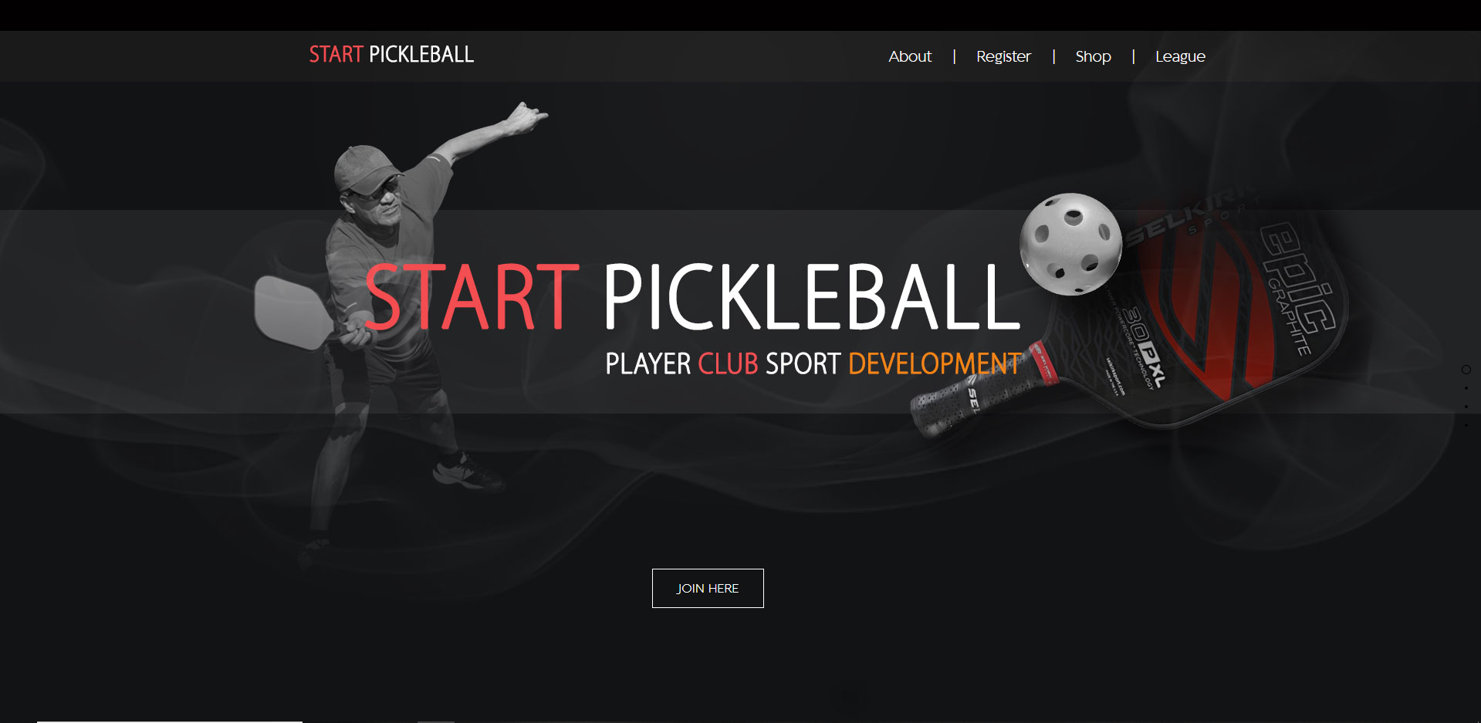
Goal
Frontend Development
Stream Line site
User Input
New Design

Slide 8

Challenges
Technical
Non-Technical
- Time management
- Requirements
- Meetings
- Ambition
- HTML
- CSS
- Photoshop
- JavaScript
-Php

Slide 9
Changes
What would I do differently?

Slide 10

Q & A

Slide 11
Project Summary
To update and enhance Start Pickleballs website design to better handle the new implements that are requested by the client in order to fulfill the members needs. To create a database for the current member information, with it being able to accept new user/member input that will be safely and securely stored into the new database.

Slide 12
WEB Development Parts
FrontEnd
HTML
CSS
MiddleWare
REST
SOAP
BackEnd
PHP
ASP
JavaScript
JSON
JSP

Slide 13
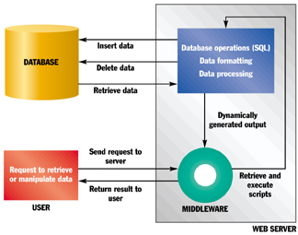
What is the purpose of middleware?
it enables multiple systems to communicate with each other across different platforms
it makes synergy and integration across those applications possible.
It enables communication and management of data in distributed applications.

Slide 14
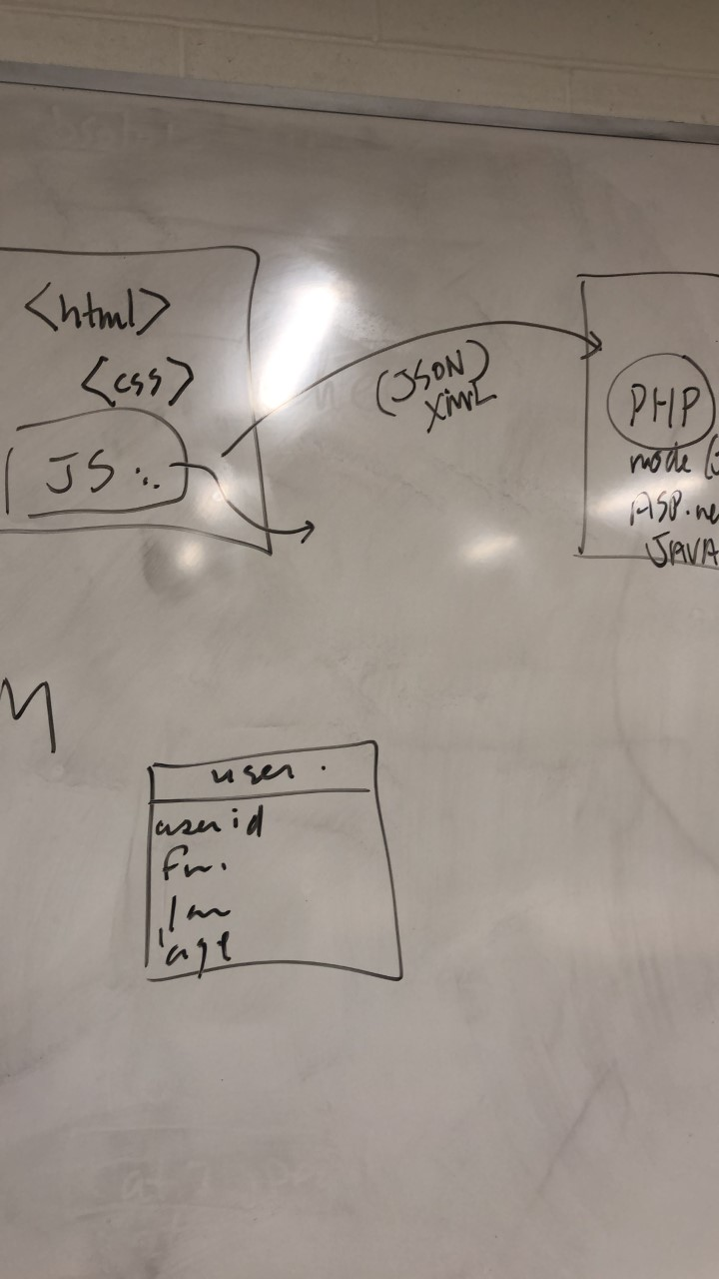
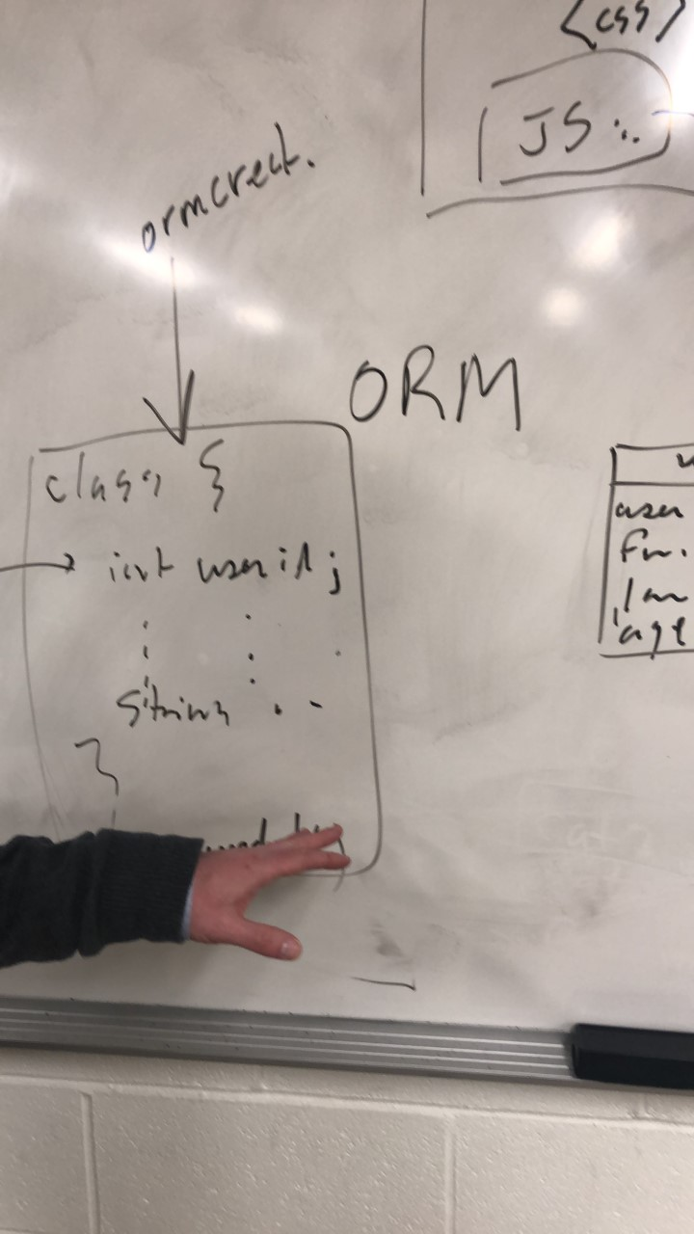
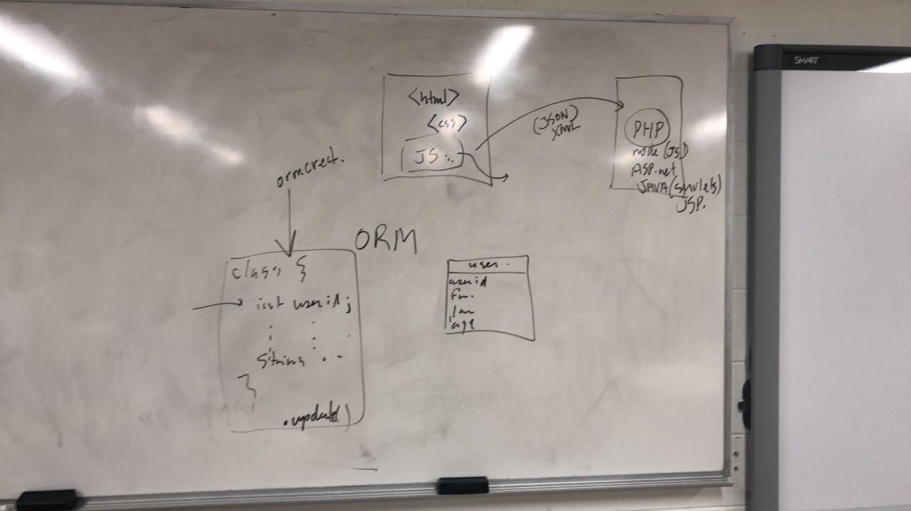
Possible Solution
JSON
LARAVEL
PYTHON
Django
FLASK

Slide 15

Laravel is deigned for MVC
What is MVC?
-Model
-View
-Controller

Slide 16
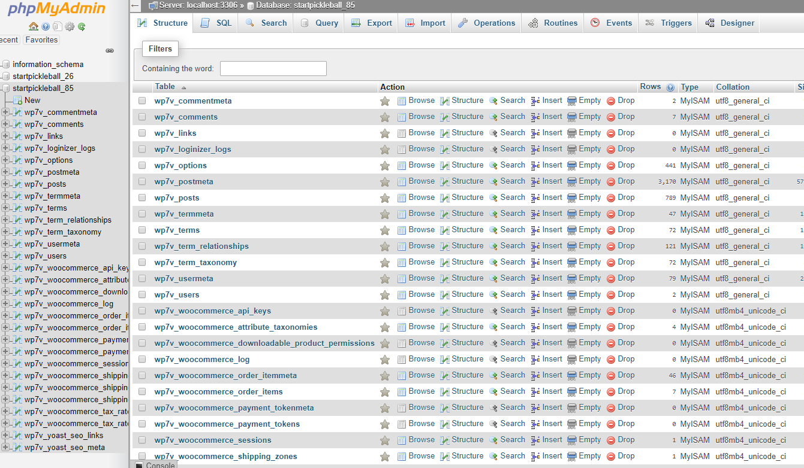
Problem/Challenge
Team Project Pickleball had to use PHP because….
StartPickeball is using PHP
MySQL already installed
Metron only allowed PHP, and JavaScript

Slide 17
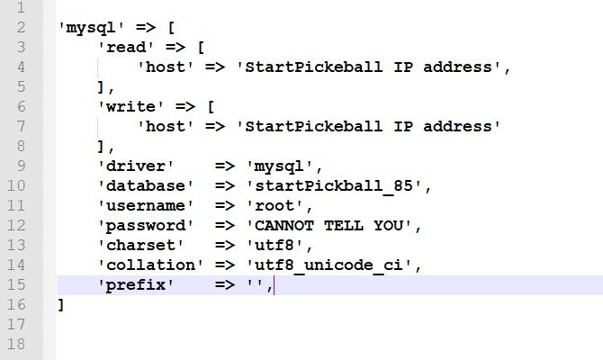
Solution
Laravel react with mysql and PHP and also
gives many features.
-Authentication
-Cashier
-Encryption(AES Encrypt)
-Hashing
-Mailing

Slide 18
QUESTION?

Slide 19
Php & MySQL
Good Partner

Slide 20
About MySQL
MySQL is an open source relational database management system (RDBMS). Its name is a combination of "My", the name of co-founder Michael Widenius's daughter, and "SQL", the abbreviation for Structured Query Language.
MySQL is free and open-source software under the terms of the GNU General Public License, and is also available under a variety of proprietary licenses. MySQL was owned and sponsored by the Swedish company MySQL AB, which was bought by Sun Microsystems (now Oracle Corporation). In 2010, when Oracle acquired Sun, Widenius forked the open-source MySQL project to create MariaDB.
MySQL is a component of the LAMP web application software stack (and others), which is an acronym for Linux, Apache, MySQL, Perl/PHP/Python. MySQL is used by many database-driven web applications, including Drupal, Joomla, phpBB, and WordPress. MySQL is also used by many popular websites, including Google (though not for searches), Facebook, Twitter, Flickr, and YouTube.
Resource: https://en.wikipedia.org/wiki/MySQL

Slide 21
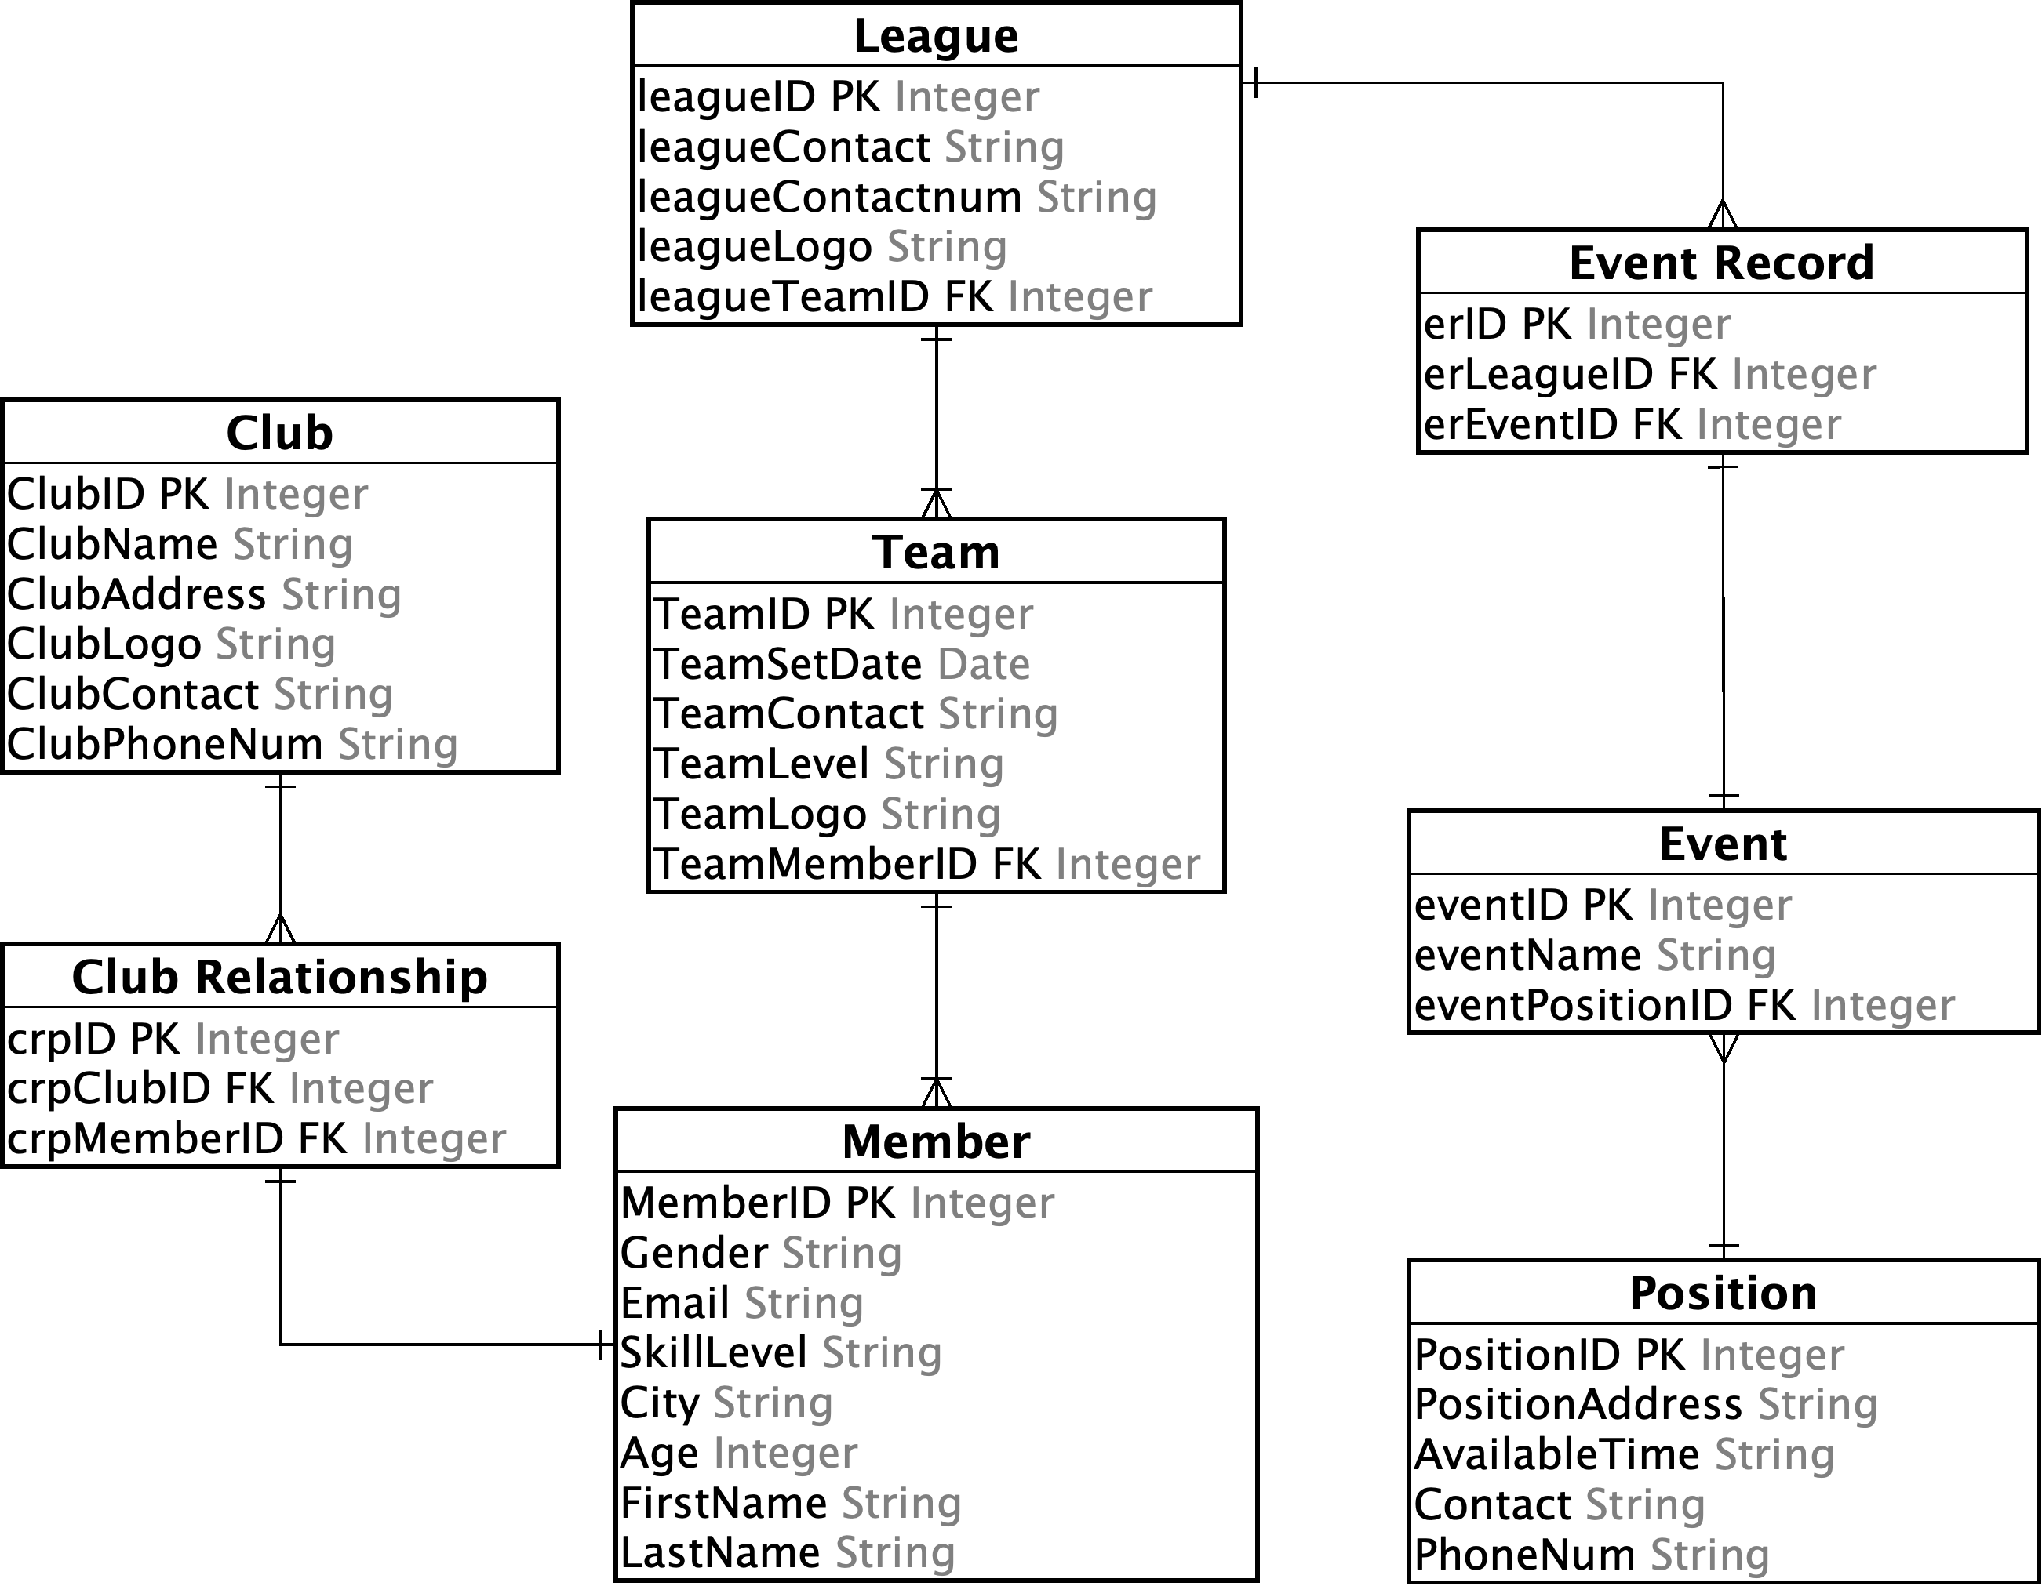
Pickleball Website Registration Database Diagram

Slide 22
Working with in MySQL
JavaScript Object Notation (JSON) is an open-standard file format that uses human-readable text to transmit data objects consisting of attribute–value pairs and array data types (or any other serializable value). It is a very common data format used for asynchronous browser–server communication, including as a replacement for XML in some AJAX-style systems. JSON is a language-independent data format. It was derived from JavaScript, but as of 2017 many programming languages include code to generate and parse JSON-format data. The official Internet media type for JSON is application/json. JSON filenames use the extension .json.
We are building a web application where we have to save a user's configuration/preferences in the database.
Source:
https://en.wikipedia.org/wiki/JSON
https://scotch.io/tutorials/working-with-json-in-mysql#toc-why-use-json

Slide 23
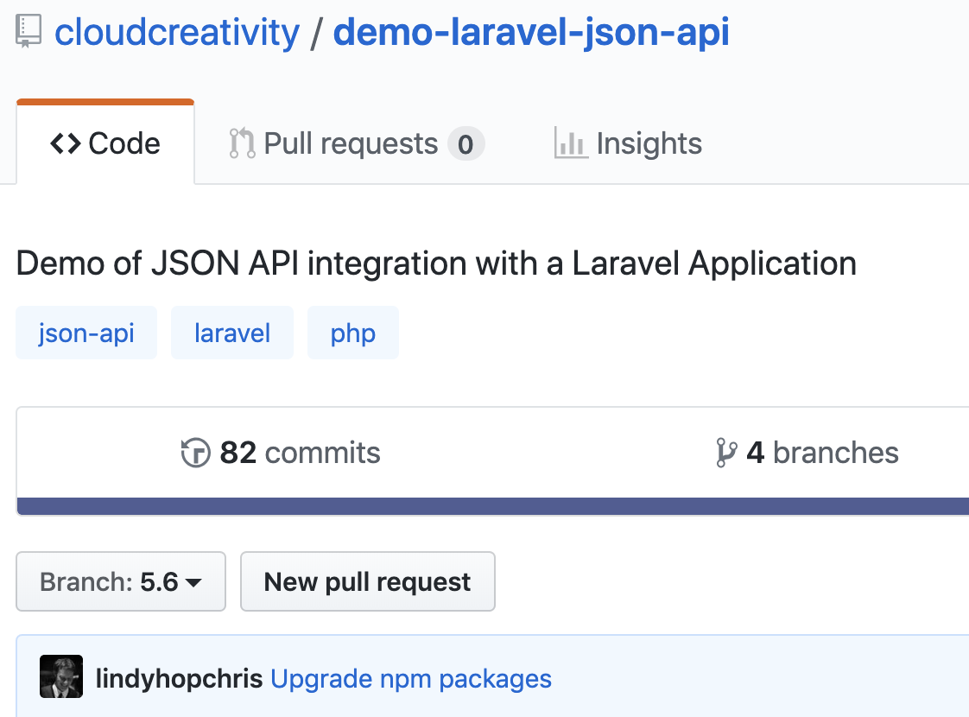
JSON & Laravel
JSON, a JavaScript Object Notation allows developers to share data amidst multiple applications and languages. It has really simple elements to store and read arrays and objects in a key-value pair. Most of the APIs today use JSON as it is convenient and globally accepted. Most often, while using Third-Party APIs, we would stumble upon JSON data. It may look very similar to JavaScript but has some differences. JSON doesn’t support comments or variables and strings should be double quoted.
Laravel supports JSON manipulations. In fact, it automatically sends JSON data as a response while querying the database when we simply return the result.
Results in JSON format can be insanely helpful for debugging the application while dealing with complex use cases or data. They provide results which are easily readable even for nested or chained objects.

Slide 24
QUESTION?

Slide 25

Project PickleBall

Slide 26
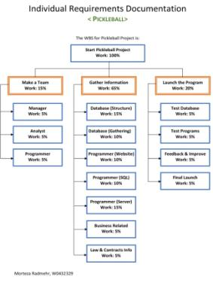
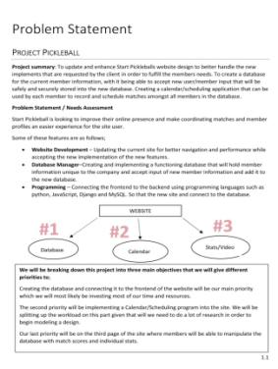
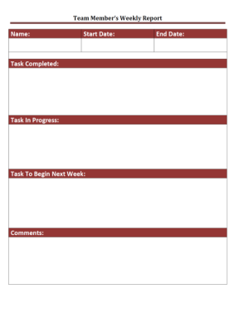

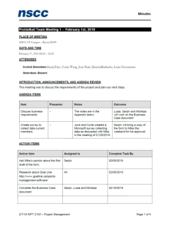
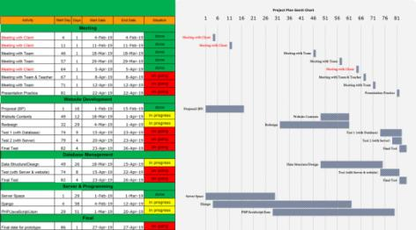
Project PickleBall
Documentation

Slide 27
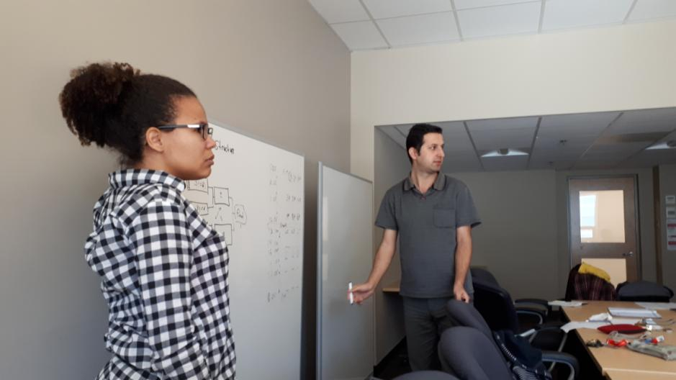
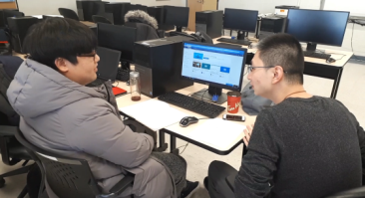
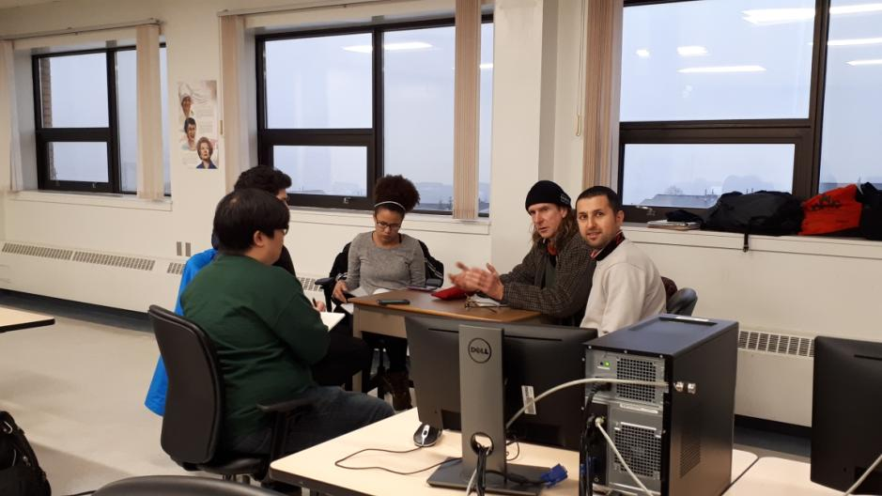
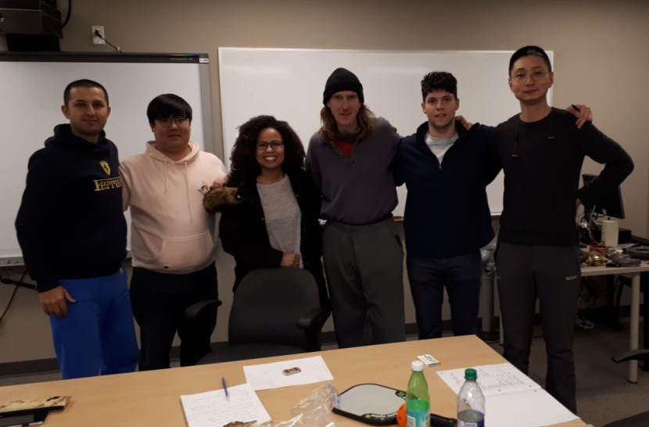
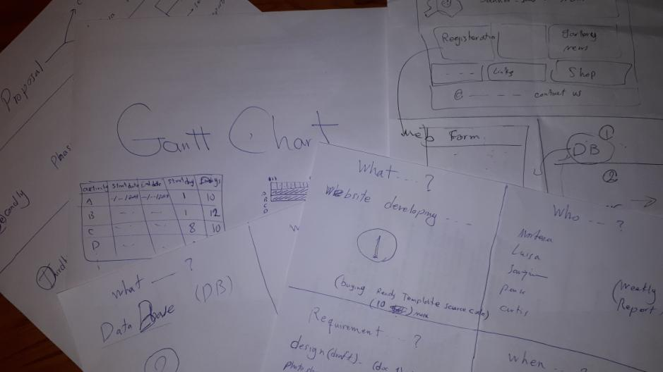

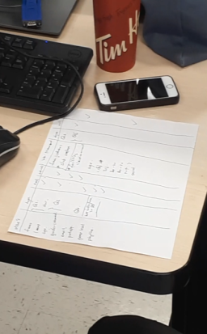
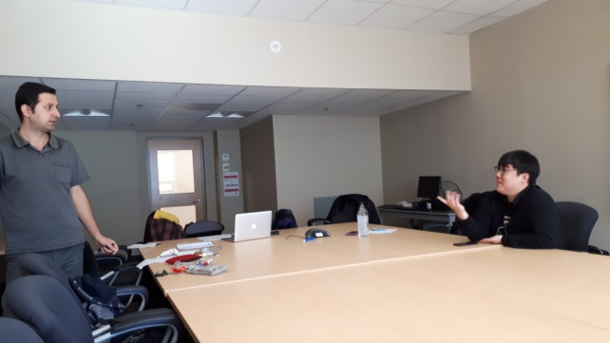
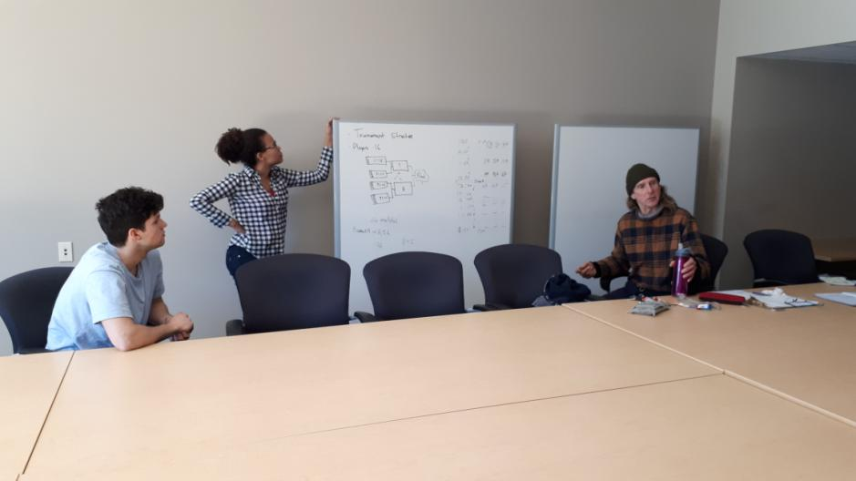
Project PickleBall
Documentation

Slide 28
Project PickleBall
 | fri | sat | sun | mon | tue | wed | thr | fri | sat | sun | mon | tue | wed | thr | fri | sat | sun | mon | tue | wed | thr | fri | sat | sun | mon | tue | wed | thr | fri | sat | sun
February | 1 | 2 | 3 | 4 | 5 | 6 | 7 | 8 | 9 | 10 | 11 | 12 | 13 | 14 | 15 | 16 | 17 | 18 | 19 | 20 | 21 | 22 | 23 | 24 | 25 | 26 | 27 | 28
 | 1 | 2 | 3 | 4 | 5 | 6 | 7 | 8 | 9 | 10 | 11 | 12 | 13 | 14 | 15 | 16 | 17 | 18 | 19 | 20 | 21 | 22 | 23 | 24 | 25 | 26 | 27 | 28
March | 1 | 2 | 3 | 4 | 5 | 6 | 7 | 8 | 9 | 10 | 11 | 12 | 13 | 14 | 15 | 16 | 17 | 18 | 19 | 20 | 21 | 22 | 23 | 24 | 25 | 26 | 27 | 28 | 29 | 30 | 31
 | 29 | 30 | 31 | 32 | 33 | 34 | 35 | 36 | 37 | 38 | 39 | 40 | 41 | 42 | 43 | 44 | 45 | 46 | 47 | 48 | 49 | 50 | 51 | 52 | 53 | 54 | 55 | 56 | 57 | 58 | 59
April |  |  |  | 1 | 2 | 3 | 4 | 5 | 6 | 7 | 8 | 9 | 10 | 11 | 12 | 13 | 14 | 15 | 16 | 17 | 18 | 19 | 20 | 21 | 22 | 23 | 24 | 25 | 26 | 27
 |  |  |  | 60 | 61 | 62 | 63 | 64 | 65 | 66 | 67 | 68 | 69 | 70 | 71 | 72 | 73 | 74 | 75 | 76 | 77 | 78 | 79 | 80 | 81 | 82 | 83 | 84 | 85 | 86
Time Table

Slide 29
Project PickleBall
Gantt Chart

Slide 30
Project PickleBall
Activity | Start Day | Days | Start Date | End Date | Situation
Meeting
Meeting with Client | 4 | 1 | 4-Feb-19 | 4-Feb-19 | done
Meeting with Client | 11 | 1 | 11-Feb-19 | 11-Feb-19 | done
Meeting with Team | 46 | 1 | 18-Mar-19 | 18-Mar-19 | done
Meeting with Team | 57 | 1 | 29-Mar-19 | 29-Mar-19 | done
Meeting with Client | 64 | 1 | 5-Apr-19 | 5-Apr-19 | done
Meeting with Team & Teacher | 67 | 1 | 8-Apr-19 | 8-Apr-19 | on going
Meeting with Team | 71 | 1 | 12-Apr-19 | 12-Apr-19 | on going
Presentation Practice | 81 | 1 | 22-Apr-19 | 22-Apr-19 | on going
Website Development
Proposal (BP) | 1 | 16 | 1-Feb-19 | 15-Feb-19 | done
Website Contents | 49 | 12 | 18-Mar-19 | 1-Apr-19 | in progress
Redesign | 32 | 29 | 4-Mar-19 | 1-Apr-19 | in progress
Test 1 (with Database) | 74 | 9 | 15-Apr-19 | 23-Apr-19 | on going
Test 2 (with Server) | 79 | 4 | 20-Apr-19 | 23-Apr-19 | on going
Final Test | 82 | 4 | 23-Apr-19 | 26-Apr-19 | on going
Database Management
Data Structure/Design | 49 | 26 | 18-Mar-19 | 15-Apr-19 | in progress
Test (with Server & website) | 74 | 8 | 15-Apr-19 | 22-Apr-19 | on going
Final Test | 82 | 4 | 23-Apr-19 | 26-Apr-19 | on going
Server & Programming
Server Space | 1 | 29 | 1-Feb-19 | 1-Mar-19 | done
Django | 4 | 58 | 4-Feb-19 | 12-Apr-19 | in progress
PHP/JavaScript/Json | 29 | 51 | 1-Mar-19 | 20-Apr-19 | in progress
Final
Final date for prototype | 86 | 1 | 27-Apr-19 | 27-Apr-19 | on going
Gantt Chart Table

Slide 31

QUESTION?

Slide 32
Cites/Resources
https://www.w3schools.com/
https://github.com/
https://www.google.com/
https://blog.hashvel.com/posts/laravel-json-data/
https://laravel-json-api.readthedocs.io/en/latest/
https://github.com/cloudcreativity/demo-laravel-json-api
https://www.w3schools.com/php/
https://en.wikipedia.org/wiki/Laravel

